Slide 1
Steganography And Deepfake Detection Using ML MINI PROJECT II (PHASE 2)
Guided By Prof. Pramod Bhide
Group members:
Rahul Tandel – 2019130063
Omkar Padir – 2019130046
Sumit Thakare – 2020301079

Slide 2
Problem definition:
Image Editor:
Editing image.
Improving Image Quality.
Improving image with different parameters.

Slide 3
Problem definition
Steganography
Hiding secret message.
Confidential communication and data storing.
Image encoding techniques.

Slide 4
Problem definition
Deep-fake detection using ML
Solution for multimodel detection technique.
Determining whether target media is manipulated or syntheticaly generated.

Slide 5
Objective
To create image editor for editing pictures.
To create steganography tool for sending secret messages.
To create Deepfake Detection tool to identify whether the given
image/video is fake or real.

Slide 6
MAJOR MODULES

Slide 7
image editor
geometry manipulator
(crop, resize, rotate, etc.)
Filters
(gray, negative, sepia, blur, edge cascading etc.)

Slide 8
steganography
take user input for text , key , image and password
encoding
Using LSB we encrypted the text into the image
take user input for image, key and password
if the password key is correct display the message
else
show error
Decoding

Slide 9
Deep-fake detection
convert video to image
prepare fake real dataset
train model
crop faces with mtcnn

Slide 10
IMPLEMENTATION DETAILS:

Slide 11
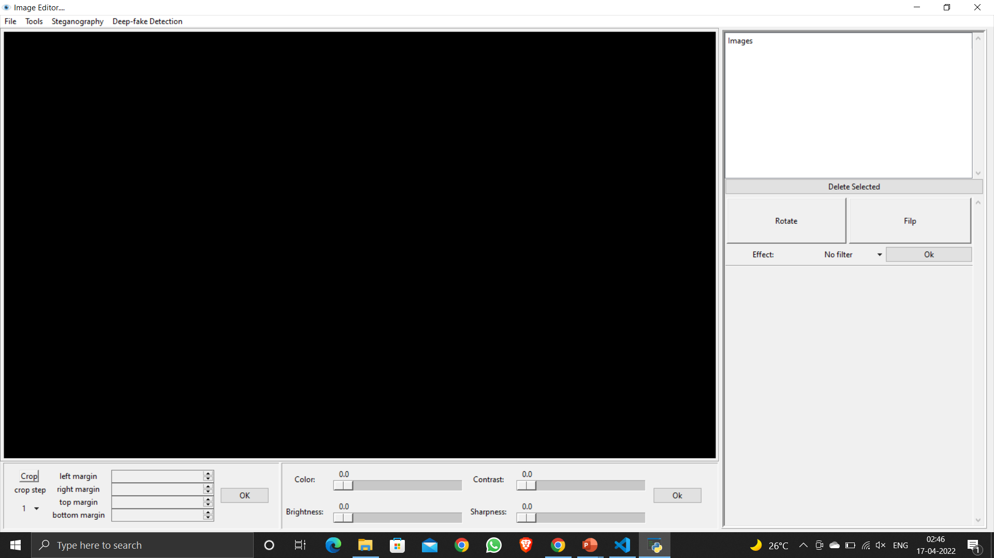
IMAGE EDITOR
Basic responsive GUI is ready
Filters added
Rotate and Resize working

Slide 12
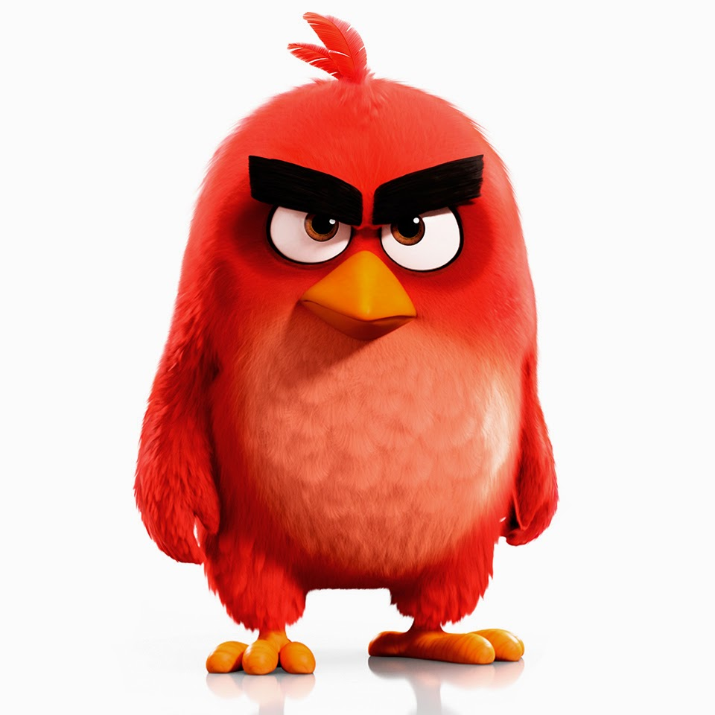
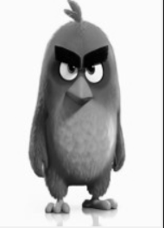
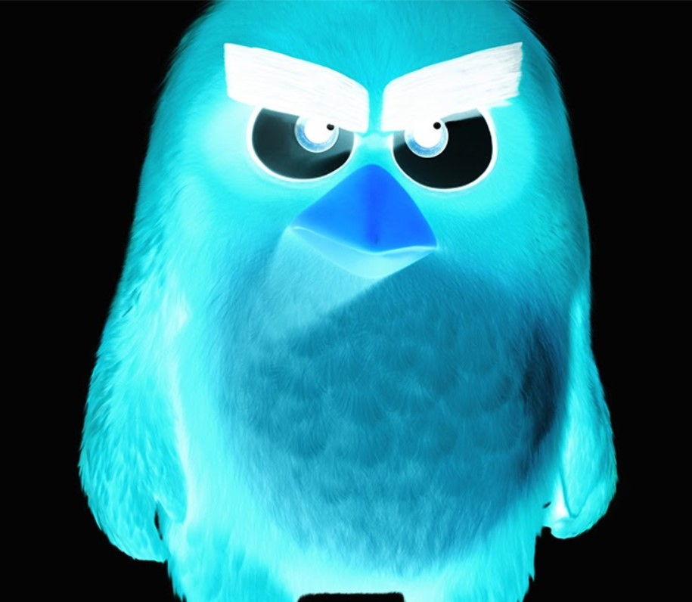
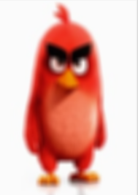
some examples of fliters
original image
Black and White
Inverted image
Blurring of Image

Slide 13
STEGANOGRAPHY:
Current Status:
program is able to encodes the text data into the image.
decodes the text data for correct key and password
displays the result
To Do::
use complete image bytes
tell user how much he can encode in particular image.

Slide 14
STEGANOGRAPHY: ALGORITHM
selected image is passed to encode function to with key, password and message.
we used cryptography library in python to change the plain text into crypto text.
we use least significant bit to store the ascii representation of character we want to store. hence we need total 3 color pixel of rgb image to store on character.
those 3 pixels are selected on the basis of password.
same reverse process is used to recover encrypted message.

Slide 15
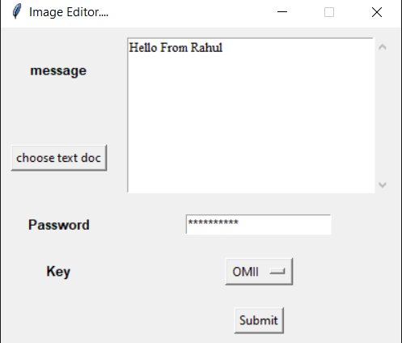
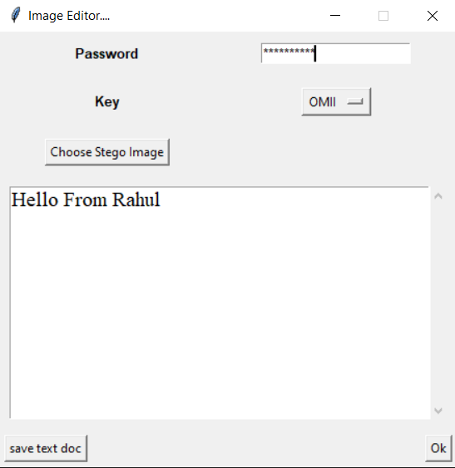
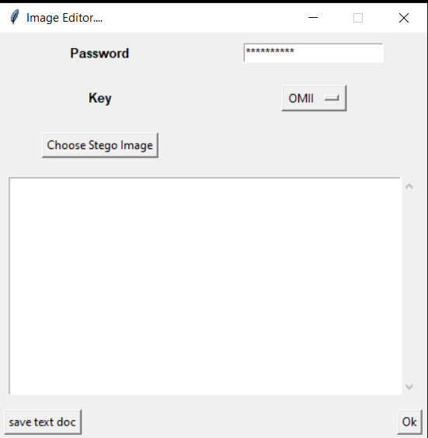
Showing Message
Encoding
Decoding

Slide 16
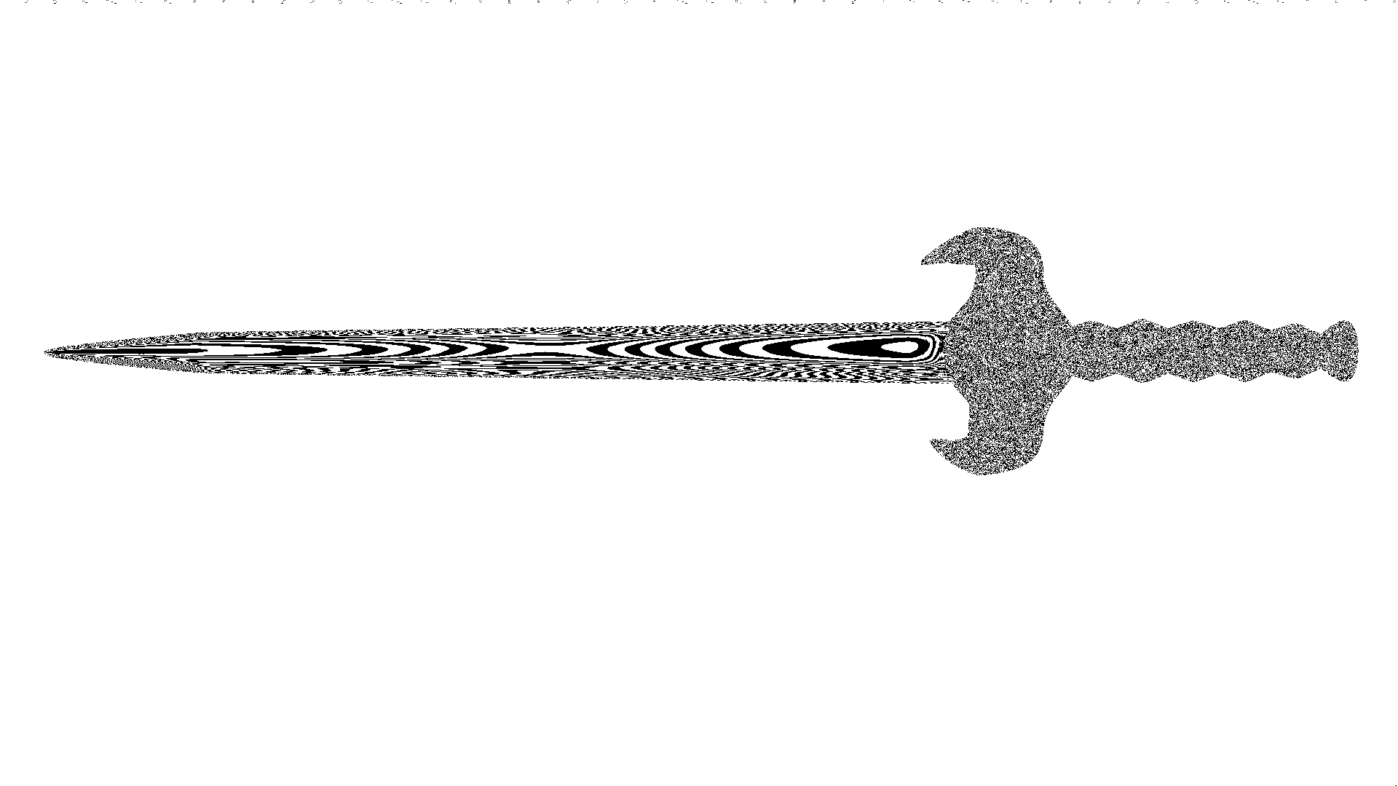
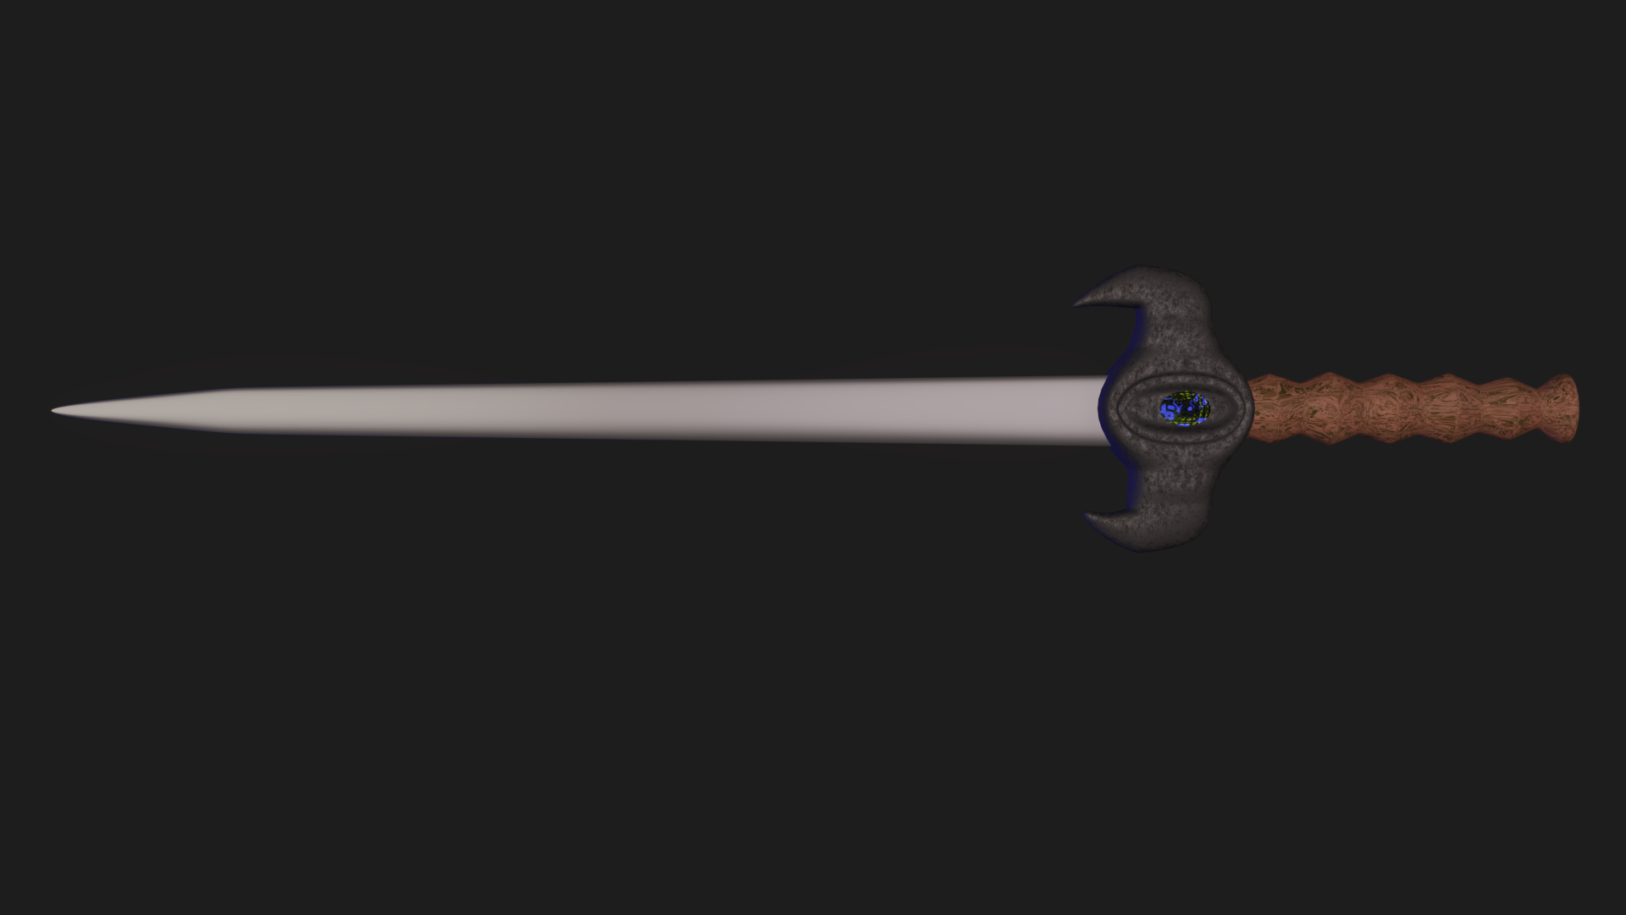
zoomed top side of the left image

Slide 17
DEEP-FAKE DETECTION:
The deep-fake detector is based on the state-of-the-art EfficientNet structure
deep-fake detection model is trained and ready to integrate in GUI.
it is trained on comparatively less amount of data
it recognises 80% of the deep-fake and real images from test dataset.
we are planning to train it with some bigger data

Slide 18
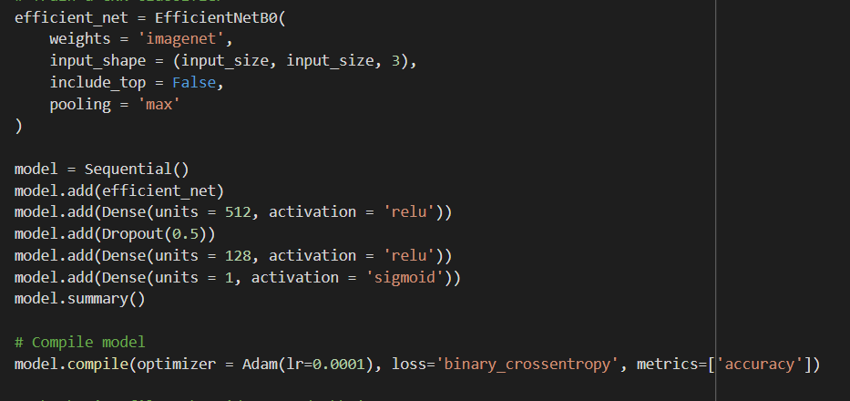
CNN model:

Slide 19
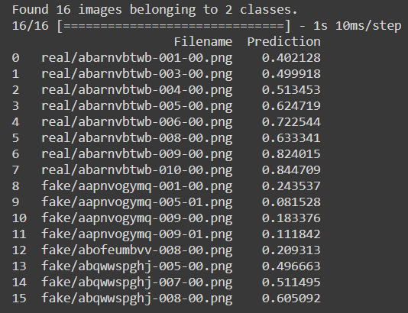
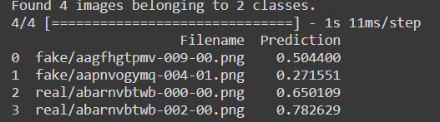
Results:

Slide 20
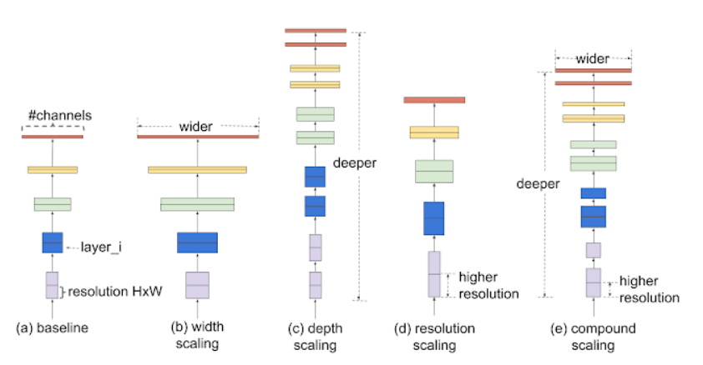
EfficientNet: compound scaling:

Slide 21
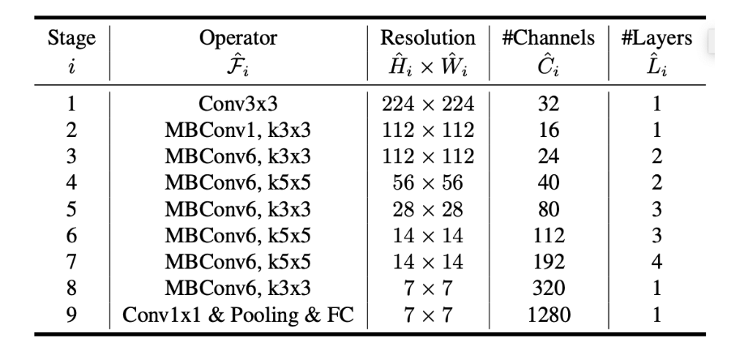
EfficientNet-B0 architecture

Slide 22
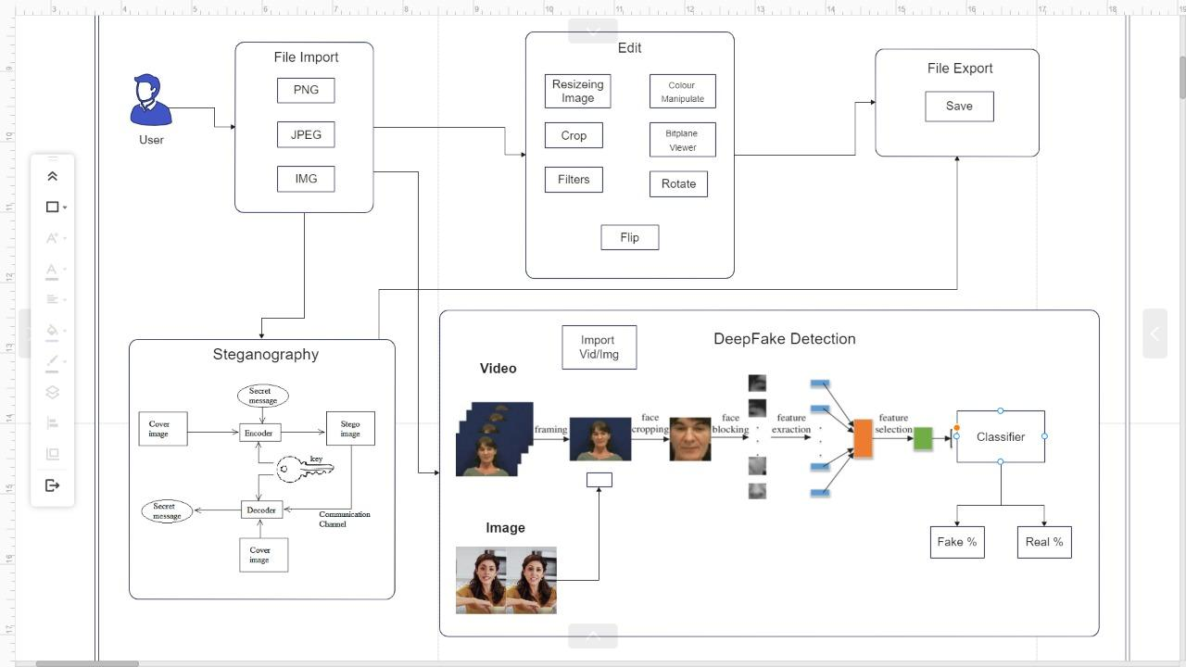
Architecture Diagram:

Slide 23
PYTHON LIBRARIES USED:
opencv-python
Pillow
tkinter
mtcnn
json
os
tensorflow and keras
math
pathlib
numpy
cryptography

Slide 24
References
For GUI using tkinter: this video has covered the tkinter python. Using this and as we need we are planning to build gui for our application. : https://www.youtube.com/watch?v=YXPyB4XeYLA
OpenCv tutorial from youtube
: https://www.youtube.com/watch?v=oXlwWbU8l2o
How to create simple image editor video: https://www.youtube.com/watch?v=gA4Uv6uE0f8&t=1346s
pillow documentation: https://pillow.readthedocs.io/
opencv documentation: https://docs.opencv.org/master/d6/d00/tutorial_py_root.html
tkinter documentation: https://docs.python.org/3/library/tk.html#:~:text=The%20tkinter%20package%20is%20a%20thin%20object-oriented%20layer,that%20implement%20the%20Tk%20widgets%20as%20Python%20classes

Slide 25
EfficientNet: Improving Accuracy and Efficiency through AutoML and Model Scaling: https://ai.googleblog.com/2019/05/efficientnet-improving-accuracy-and.html
Steganography in Images Using LSB Technique (2010): http://www.ijltet.org/wp-content/uploads/2015/02/60.pdf
EfficientNet: Rethinking Model Scaling for Convolutional Neural Networks: https://arxiv.org/pdf/1905.11946.pdf
System Diagram :https://www.edrawmax.com/online/app.html

Slide 26
Thank you

